Slide 1
Impulse
Impulse is an online portal with a sterling vision to help fight the Covid-19 virus which is voraciously gripping the world in its entirety.
The application provides a system to detect the virus, and also prevents crowd formations but at the same time, fulfil the basic needs of the people, without hampering the rules of the lockdown. It also bridges the gap between the seller and the buyer, which helps in practicing social distancing.

Slide 2
Goals
Eliminating Crowding at stores by implementing token system
Current info regarding COVID cases , cured and death , to keep user updated
Bridging the gap between consumer and provider by connecting them . (buyer-farmer , citizen-vendors)
Coronavirus infected prediction
An Portal where people can ask for help , and get help by those who are providing it
01
03
04
05
02

Slide 3
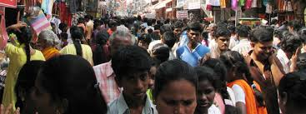
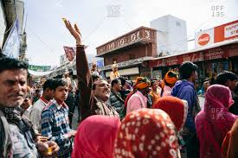
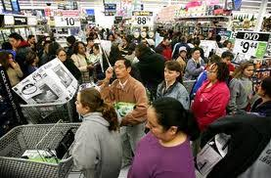
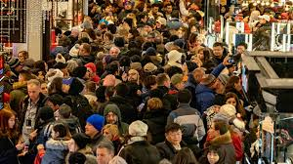
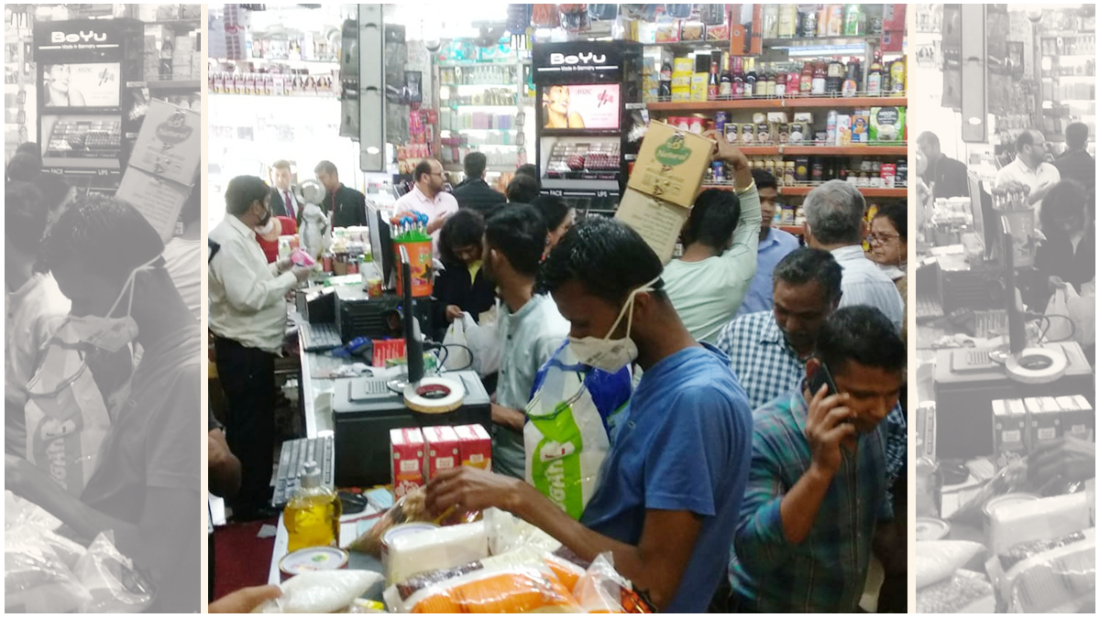
Social Distancing
Problem :-
One of the main problem for spread of coronavirus is because of inadequate social distancing
We generally see crowds near Grocery Store , Medical Clinics and various other stores.
Due to these overcrowding,India is daily recording 300+ cases even after imposing lockdown.

Slide 4
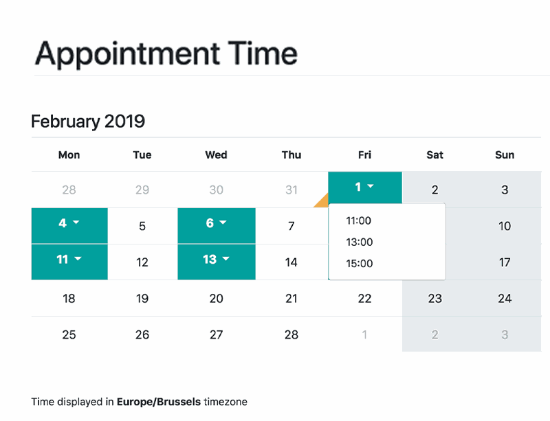
Solution :-
We design an environment where shop owner and customer register online.
The user can book slots(date and time) as per his/her convenience.
The store admin will be made aware of the same.
And each slot has limited amount of users.
Hence , “SOCIAL DISTANCE” will be maintained as well as people will not be affected.

Slide 5
AgroCraft
System that provides farmers an interface to sell their product, and connect with the buyers all over India.
Interface for anyone to buy the farm product.
Agrocraft, is an online portal with a pure vision to consolidate farmers and buyers who can both be consumers or restaurant owners, and abolish the system of middlemen.
Simple interface that works on smart devices, SMS to upload product details and respond via phone and SMS or farmer can add their product directly on website with few steps.

Slide 6
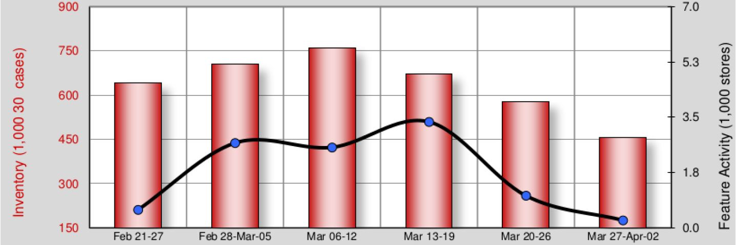
Problems
The supplier - buyer chain is affected drastically due to the lack of supply and transportation due to lockdown.
The police restricts the vegetable vender to sell their products due to overcrowd of consumers.
Due to which the farmers are not able to sell their products which cause rapid decrease in their income.

Slide 7
Process
The farmer registers on the Online portal..
The farmer can now upload his product via SMS, Website, Call.
.
The farmer will be shown Minimum Selling Price, to give him estimate value.
The buyer would able to view all the products according to categories and region
Once the order is confirmed ,farmer or transport agency can deliver the product or buyer can come to the farm
For the transportation and delivery of the products, permission is to be granted by the government.

Slide 8
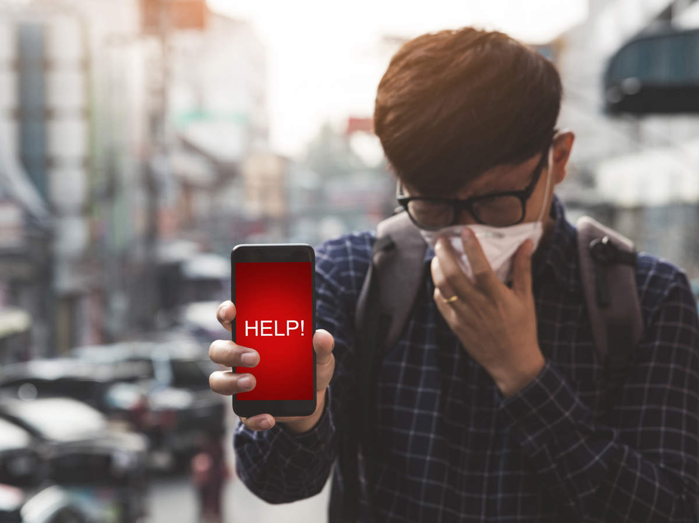
HELPING HANDS
Problems :-
Facebook , whatsapp and other social media accounts are getting filled with the request of people who need help, but no proper actions are taking place either the potential people living in that area are not able to find out or its getting lost like other messages do , and the same people continues to suffer .
Due to Coronavirus many business closures in various sectors, are falling shortage of resources and materials like medicine, grains, fruits and vegetables etc .

Slide 9

Solution :-
We have built up a portal where registered user can provide help to those who need them , and can even ask for help in our local vicinity .
The registered user can also Filter help request based on various categories like medical , food products , etc and area.
The identities of both the user will be kept private and not be disclosed until permission given by user itself
The potential users can help by supporting local food bank,donating blood, providing items like medicines , and grains ,Donating money ,etc

Slide 10

We also detect whether the user is infected or not based on certain parameters and symptoms , using the machine learning model .Which can be used in hospitals to filter out important cases for testing , and to take Early actions.
The portal will also provides the latest information about current situation around the globe , with the total number of cases , cured and death with respect to countries and its state , this data will be represented in tabular and graphical format for better visual and understanding

Slide 11
Thank You

